Slide 1
MCE Joint Presentation

Slide 2
Agenda For Meeting
INTRODUCTIONS AND BACKGROUND
MCE CONTRACT OVERVIEW
QUESTIONS
MCE PROVIDER OUTREACH
PROVIDER PORTAL OVERVIEW
Notes:
We’ll be making the slide deck and recording available

Slide 3
MCE HCBS Provider Outreach and Contracting Contacts *
Anthem
April Walton
INmltssproviderrelations@anthem.com
219-742-5323
Humana
Terry King
LTSSContracting@humana.com
866-274-5888
UnitedHealthcare
Dorian Trice
IN_providerservices@uhc.com
763-361-1650

Slide 4
Overview of Key Documents for Provider Contracting
Contract Overview:
Anthem | Humana | UHC
All MCEs required a completed digital application
Required documents W-9 Copy of Division of Aging certification Copy of current Certificate of Insurance (COI) | Required documents W-9 Copy of Division of Aging certification License if applicable | Required documents W-9 Copy of Division of Aging certification Copy of IRS letter with EIN and Business Name

Slide 5
Overview of Provider Portals
Both Anthem and Humana use Availity (www.availity.com)
UnitedHealthcare uses a proprietary system, UnitedHealthcare Provider Portal.
All have the following capabilities:
View Service authorizations
Claims submission
Remittance advice download
Provider profile management

Slide 6
How to Register for Availity
Both Anthem and Humana use Availity.
Providers who are new to Availity can initiate registration on Availity Essentials at Availity.com.
All Providers start the registration process by navigating to Availity.com and Selecting “get started” from the top right corner of the Availity website screen.
Notes:
Availity Essentials offers secure access to manage daily transactions with payers.
Availity Essentials does not require special software, and is accessible with high-speed internet, using Google Chrome/Microsoft Edge/Firefox browsers.
Availity Essentials features:
Electronic transactions provides a secure platform where providers can perform eligibility and benefit inquiries, check claim status, and track remittance.
Multi-payer portal ensures a consistent workflow for all participating health plans, allowing providers the same user experience.
Through this multi-payer portal, providers can access several Anthem's Care Central application, the one-stop shop for LTSS providers.
What’s needed to get started?
- All organization types — Only the person who will be designated as the administrator needs to register. The following information is needed:
Physical and billing addresses
Tax ID (EIN or SSN)
NPI (if you have one)
Primary specialty/taxonomy

Slide 7
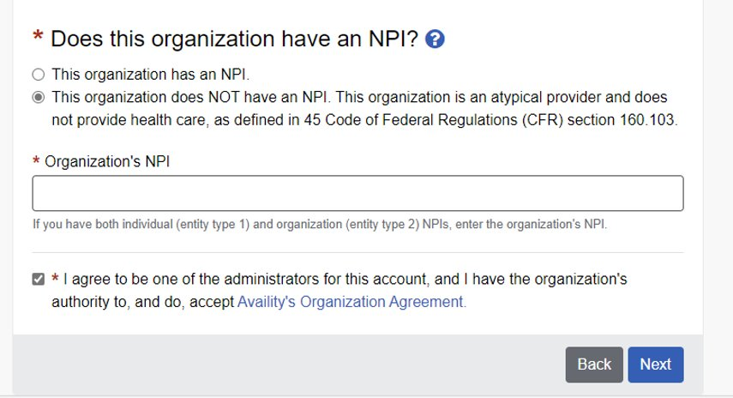
Atypical Provider Organizations
Atypical providers should select the option “This organization does NOT have an NPI. This organization is an atypical provider and does not provide healthcare as defined in 45 Code of Federal Regulations (CFR) section 160.103.

Slide 8
How to Contract with Anthem Digital Provider Enrollment Tool (DPE)
LTSS providers, including atypical providers who do not have a National Provider Identifier (NPI), wishing to participate in the Indiana Pathways for Aging Program with Anthem Blue Cross Blue Shield can apply digitally by utilizing our automated Digital Provider Enrollment tool hosted on the Availity Portal.
The tool is available by selecting the “Provider Enrollment” square on the Anthem Payer Space page.

Slide 9
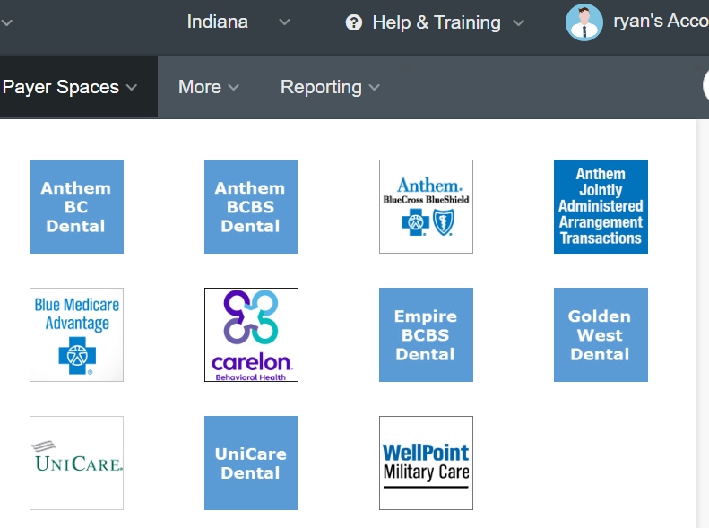
Anthem’s Payer Spaces
Payer Spaces
Providers can access Payer Spaces from the main Availity dashboard by selecting the payer spaces tab.
Selecting the Payer Spaces tab will populate all the payers available to the provider to select from.

Slide 10
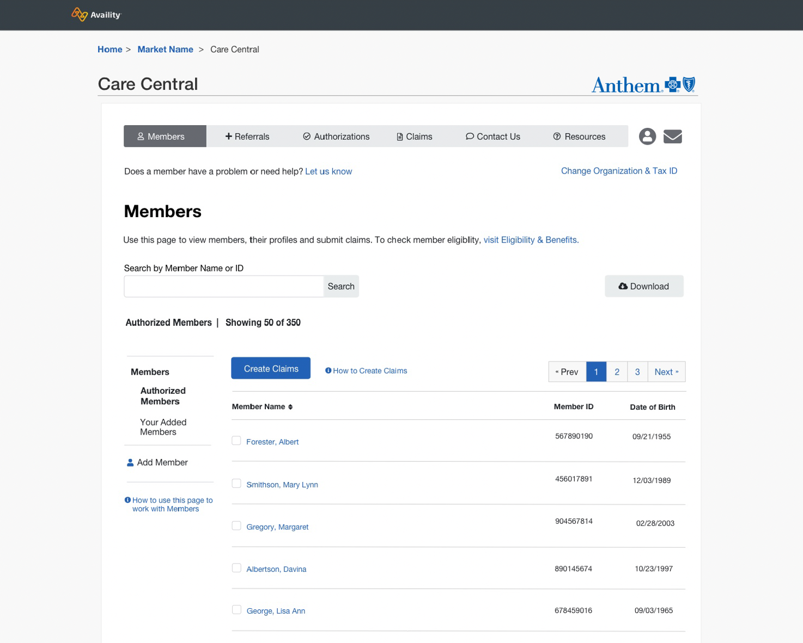
Anthem’s Care Central Portal
Accessible through Availity Essential’s Payer Spaces, Care Central is a one-stop shop for LTSS/atypical providers, with tailored billing, referral and multiple dashboards to support member management, which:
Enables a simplified, seamless and tailored online experience reducing administrative burden.
Reduces errors, manual processes, and obsolete technology.
Empowers the provider with quick access to information necessary to initiate and maintain member care.
Provides clear line of site into critical data and reporting.

Slide 11
Anthem’s Digital Provider Enrollment tool dashboard
Providers are taken to the Enrollment Dashboard page, where they can select Begin New Application to submit their enrollment.

Slide 12
Anthem’s Digital Provider Enrollment-Helpful Reminders
Providers will want to choose LTSS (Long-term Service Support) when selecting from the What type of provider are you? Field.
Reminder to providers on the required documents needed to complete their application, including:
A copy of your Division of Aging Waiver and accreditation/certifications.
Required documents with your application include a current W-9, Copy of certification document through the Division of Aging and Indiana Medicaid, Copy of the Secretary of State letter, and Certificate of Insurance (COI).
The dashboard page also allows providers to check the status of their applications, once submitted.

Slide 13
Anthem Provider Education/Training and Outreach
Go-live support:
Dedicated Provider Relations representative: Long-term services and supports (LTSS) providers will be assigned a local and dedicated Provider Relations representative, equipped with the expertise to offer comprehensive support and resources. Leading up to implementation, the team is offering ongoing office hours to walk providers through the Digital Provider Enrollment tool and will offer in-person or virtual support to include individualized training, resources, and tools dependent on your needs and preferences.
Monthly office hours: We will offer virtual monthly office hours where providers may connect with Anthem’s LTSS Provider Relations team to get answers to questions or seek technical assistance in preparation for implementation.
LTSS provider webinars: We will host monthly webinars covering a variety of LTSS provider-focused topics designed to support you in the Pathways for Aging implementation.
Anthem provider essentials:
Anthem’s Indiana Pathways for Aging Quick Reference Guide
Anthem’s Indiana Pathways for Aging Provider Manual
Registration for claims submission
Enrollment in electronic funds transfer
Anthem’s comprehensive Training Support, to include topics such as:
Claims and billing
Authorizations
Person-centered planning
Accepting referrals
HCBS settings rule
Workforce development
Value-based programs

Slide 14
Your Anthem LTSS Provider Relations Team
Provider Relationship representatives
Northern Indiana
Latasha Cobb
317-503-0843
LaTasha.Cobb@anthem.com
Central Indiana
David Castaneda
317-503-0843
David.Castaneda@anthem.com
Southern Indiana
Haley Osborne
317-671-2141
Haley.Osborne@Anthem.com
LTSS Provider Relations email: INMLTSS@ProviderRelations@anthem.com
Website: Indiana Pathways for Aging | Anthem
Map: Indiana PathWays for Aging Network Relations Map and Supports
Additional resources and contacts:
Workforce Development Administrator
Amanda Wills Amanda.Wills@anthem.com
317-671-3220
LTSS Provider Training Specialist
Ryan Fennessy
Ryan.Fennessy@anthem.com
317-671-3220
HCBS Contracting Network Specialist
April Walton
April.Walton@Anthem.com
219-742-5323

Slide 15
How to Contract with Humana
Step 1: Enroll with Indiana Health Coverage Programs (IHCP) – Collect your Division of Aging Waiver Certification Letter to submit to Humana.
Step 2: Initiate Request to Join Humana Network:
Note: Ability to initiate network participation request through Humana.com to be available Q1 2024
Step 3: Your dedicated HCBS provider contractor will outreach to you within the next business day and provide you an email link to submit your demographic assessment form and other required documents. A copy of your Humana Agreement will also be provided upon complete application.
Step 4: Return your documents to Humana. Humana provides the flexibility to return your documents electronically (through link provided by your contractor) including ability to sign your Agreement through a secure Adobe Sign electronic application, or if preferred Humana will accept documents returned via mail or email.
Humana Mailing Address: PO Box 74007 Louisville, KY 40201

Slide 16
Humana Provider Education/Outreach
Humana Will Work to Reduce Administrative Burden and Enable Success
Dedicated Provider Education/Outreach Representative
Provider Engagement & Training
Provider Website & Self-service Tools
Continued Provider Support and Education
Provider Education & Training Overview:
Dedicated HCBS Provider Relations Team
Weekly/Monthly/Quarterly provider education and training
Customized training plan
Provider Education office visits
Townhalls/Office Hours/Provider Forums
Assist with technological challenges and/or accommodation support
Contact for any questions or concerns
MCE collaboration
Humana Healthy Horizons in Indiana Provider website: https://www.humana.com/provider/medical-resources/indiana-medicaid

Slide 17
Humana Provider Education Team Contact Information
Denise Watson, Director of Provider Engagement
: Phone 463-280-5327 | *: dwatson31@humana.com
Kevin Cox, Manager of Provider Engagement
: Phone 812-572-0110 | *: kcox23@humana.com
Bria Steele, Provider Engagement
: Phone 317-677-2693 | *: bsteele13@humana.com
Cindy Cobb, Provider Engagement
: Phone 317-991-2896| *: ccob7@humana.com
General Questions or Concerns
: Phone 866-274-5888| *: INMedicaidProviderRelations@humana.com

Slide 18
How to Contract with UHC
The HCBS contracting portal will be live 1st quarter 2024. Detailed instructions can be found at:
How to Join the UnitedHealthcare network | Indiana | UHCprovider.com

Slide 19
Training offered by UHC
Side by Side and Group Training
in_providerservices@uhc.com
Virtual or in person Q&A and training sessions
Instructor Lead Training
Instructor-Led Learning Events | UHCprovider.com
Claims Overview/Portal
Document Library
Self-Paced Training
Digital Solutions Training and Guides | UHCprovider.com
UnitedHealthcare Portal Tools
Portal Overview
Chat

Slide 20
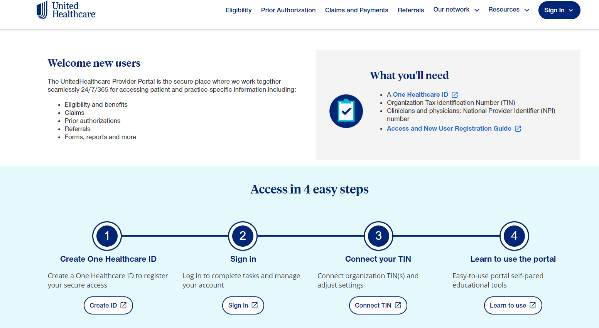
One Healthcare ID
Provider portal registration | UHCprovider.com

Slide 21
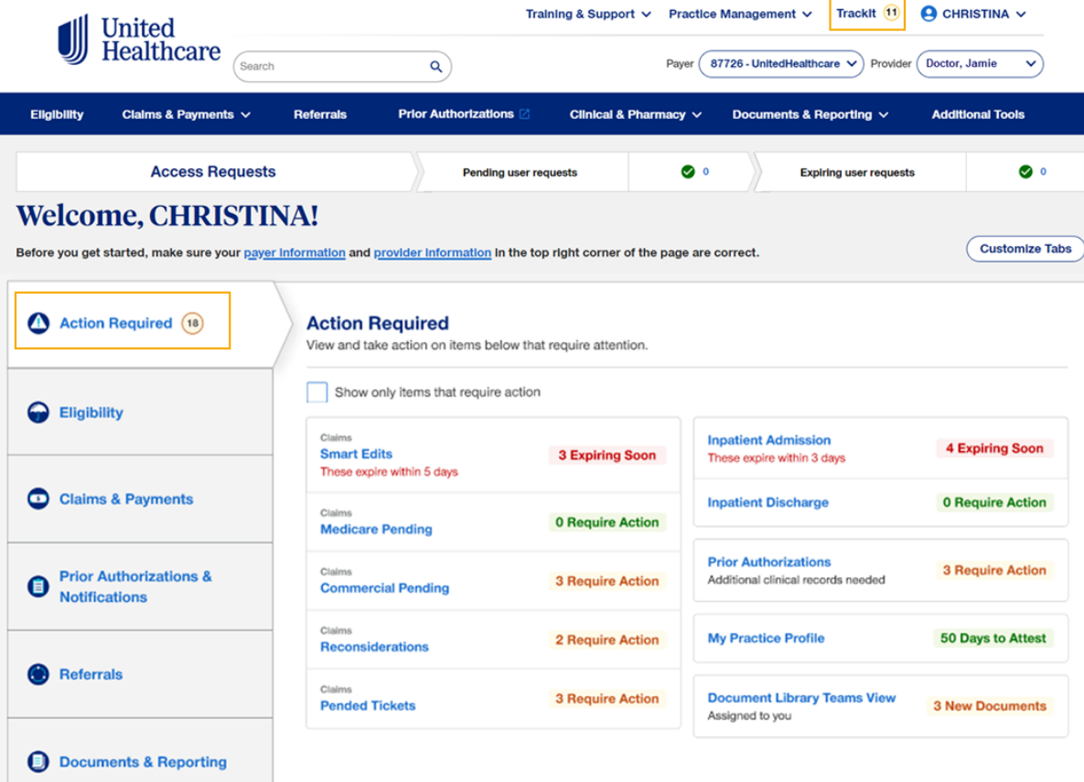
Portal Dashboard-UHC
Every user has a dashboard

Slide 22
UnitedHealthcare Provider Contact Information
HCBS Provider Lead | Provider Services Director | Provider Services Manager
Dorian Trice | Amanda Wilson | David Hoover
IN_providerservices@uhc.com | Amanda_Wilson@uhc.com | David_Hoover@uhc.com
763-361-1650 | 317-352-6600 | 317-275-8269
Additional Resources and Contacts
Website | www.uhcprovider.com/INcommunityplan
Workforce Development Administrator | Joanna Peak Joanna_peak@uhc.com
Service Coordination General Mailbox | in_service_coordination@uhc.com

Slide 23
Q & A

